Slide 1
FRESHERS TRAINING
Program Execution
OS
Day Incharge : Seshagopalan
Session Handler : Lucky Tyagi
(lucky.j@e-consystems.com)
INTRODUCTION
TO
Cross
Compile
Linux
Commands
GCC
Compiler
Vim
Sample
C Code

Slide 2
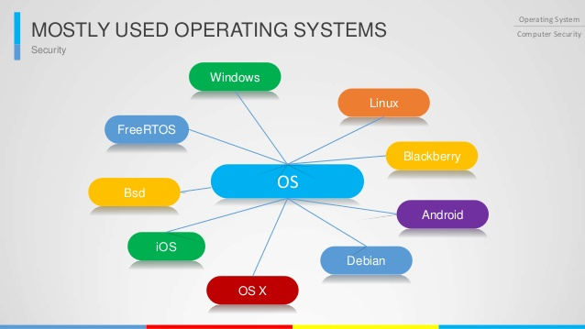
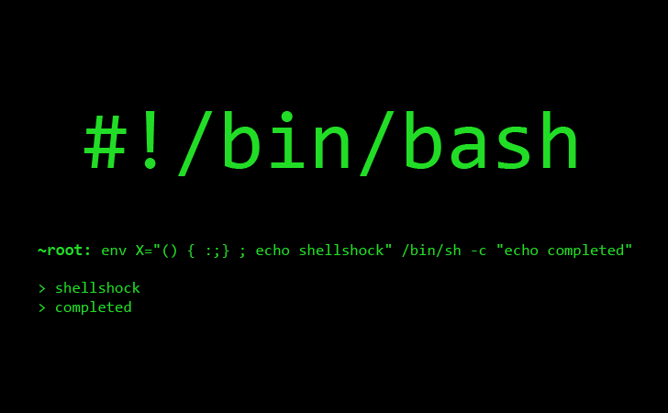
Operating System
What is it ?
What does it do ?
Types
Linux - OS
Boot Process of Linux System
Workstation
Embedded System
Linux Commands
Terminal Vs. Console
Shell
Sample Commands
Shell Script
Sample Shell Script

Slide 3


Vim Usage
What is it ?
What does it do ?
Create and save a file
Customization
Local
Global
Navigation Shortcuts
GCC Compiler
What is it ?
What does it do ?
Compilation Stages
Debug info
Sample examples
Compiling a C code
Verbose output discussion

Slide 4

Cross-Compilation
What is it ?
Why is it needed ?
How it works ?
How to use it ?
Open Discussion
How a program runs on a
processor ?

Slide 5
Operating System

Slide 6
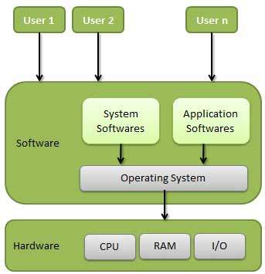
An operating system is a program that acts as an interface between the user and the computer hardware and controls the execution of all kinds of programs.
Important functions of an OS :
Memory Management
Processor Management
Device Management
File Management
Coordination between other software and users
etc.
Types of OS :
Batch Operating System
Time-Sharing Operating System
Distributed Operating System
Network Operating System
Real Time Operating System

Slide 7
Linux OS
Components of Linux OS :
Bootloader
Manages the boot process of your computer.
Kernel
Kernel is the core part of Linux.
Responsible for all major activities.
Interacts directly with the underlying hardware.
System Library
Special functions or programs using which application programs or system utilities accesses Kernel's features.
Daemons
Background services (printing, sound, scheduling, etc) that either start up during boot, or after you log into the desktop.

Slide 8
Linux Boot-Up Process

Slide 9






Linux Workstation

Slide 10






Basic Input/Output System
Performs some system integrity checks
Searches, loads, and executes the boot loader program.
Once the boot loader program is detected and loaded into the memory, BIOS gives the control to it.
BIOS loads and executes the MBR boot loader.

Slide 11
Master Boot Record.
It is located in the 1st sector of the bootable disk.
Contains information about GRUB
This has three components
Primary boot loader : 446 bytes
Partition table : 64 bytes
MBR validation check : 2 bytes.
MBR loads and executes the GRUB.

Slide 12
Grand Unified Bootloader.
If multiple kernel images are installed on your system, you can choose which one to be executed.
GRUB has the knowledge of the filesystem.
GRUB just loads and executes Kernel and initrd images.

Slide 13
?

Slide 14
0
HALT
Single User
Mode
Available
Runlevels
1
Multiuser
Looks at the /etc/inittab file to decide the Linux run level.
Uses that to load all appropriate program.
Set the default run level to 0 or 6.
Typically you would set the default run level to either 3 or 5.
2
Multiuser
Unused
X11
3
Reboot
4
5
6

Slide 15
/etc/rc*.d/

Slide 16
Embedded Linux
After a processor is reset, it executes ROM startup code.
The ROM startup code initializes the CPU, memory controller, and on-chip devices, and it configures the memory map. The ROM startup code then executes a bootloader.
The bootloader decompresses the Linux kernel into RAM from boot device. It then executes a jump to the kernel's first instruction. The kernel first configures microprocessor registers and then invokes the architecture-independent starting point.
The kernel initializes various hardware devices.
The kernel mounts the root filesystem.
The kernel executes the init process.
init reads its configuration file, /etc/inittab, and executes scripts. Typically, init executes a startup script, which configures and starts networking and other system services.
init enters a runlevel where system duties can be performed or the login process can start, allowing for user sessions.

Slide 17
Linux Commands

Slide 18
Shell, Terminal and Console
SHELL
The shell is the program which actually processes commands and returns output.
Shells also manage foreground and background processes, command history and command line editing.
TERMINAL
A terminal refers to a wrapper program which runs a shell.
Decades ago, this was a physical device consisting of little more than a monitor and keyboard.
Later this terminal concept was abstracted into software.
Now you have programs which launches a window in a windowing environment which will run a shell into which you can enter commands.
CONSOLE
The console is a special sort of terminal.
These are accessed through key combinations (e.g. Alt+F1 or Ctrl+Alt+F1) which are handled at low levels of the linux operating system -- this means that there is no special service which needs to be installed and configured to run.
Interacting with the console is also done using a shell program.

Slide 19
Shell Command
A command is an instruction given by a user telling a computer to do something, such as run a single program or a group of linked programs.
Commands are generally issued by typing them in at the command line (i.e., the all-text display mode) and then pressing the ENTER key, which passes them to the shell.
A command consists of a command name usually followed by one or more strings (i.e., sequences of characters) that comprise options and arguments. Each of these strings is separated by white space (which consists of one or more spaces or tabs). The general syntax for commands is :
command [options] [arguments]
Important Tips :
Pipelining (|)
Filtering
Redirection (>), etc.

Slide 20
Vim Usage
Create a sample .c file (hello.c)
Save and exit. (:w :q)
Open again and edit. (set <property>)
How to SET properties Permanently?
set number
set relativenumber
set hlsearch
In order to replace text, you have to make use of Command mode. In Command mode, the s command is for substitution in the current line, %s for substitution in the whole file, and <begin>,<end>s for substituting from <begin> line number to the <end> line number.
Cut, Copy and Paste

Slide 21
GCC Compiler

Slide 22
History and Introduction
The original GNU C Compiler (GCC) is developed by Richard Stallman, the founder of the GNU Project.
GCC, has grown over times to support many languages and is now referred to as "GNU Compiler Collection".
GCC is a key component of "GNU Toolchain", for developing applications. The GNU Toolchain includes:
GNU Compiler Collection (GCC)
GNU Make
GNU Binutils
GNU Debugger (GDB)
GNU Autotools
GNU Bison
GCC is portable and run in many operating platforms.
GCC is also a cross-compiler, for producing executables on different platform.

Slide 23
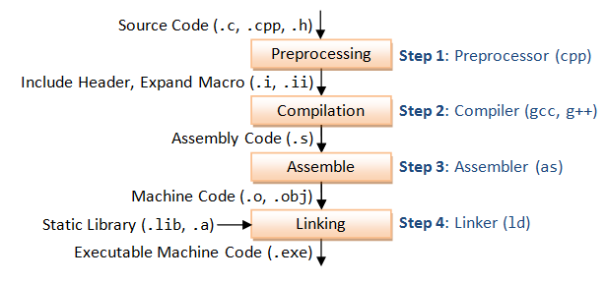
Getting Started
Checking version : $ gcc --version
More info : $ gcc -v
Compiling : $ gcc hello.c
Running executable : $ ./a.out
Stages of GCC Compilation
Pre-processing : $ gcc -E
Compilation : $ gcc -S
Assemble : $ gcc -c
Linking : $ gcc
Save all temporary files : $ gcc -save-temps
Link with Shared Libraries : $ gcc -l<lib_name>
Warnings to error : $ gcc -Werror

Slide 24
Cross Compilation

Slide 25
CROSS-COMPILER
A cross compiler is a compiler capable of creating executable code for a platform other than the one on which the compiler is running.
A platform could be infeasible for a compiler to run on, such as for the microcontroller of an embedded system because those systems contain no operating system.
USES
Embedded Computers
Compiling for multiple machines
Compiling for Emulators
MACHINE A MACHINE B MACHINE C
WINDOWS MAC OS X ANDROID
IA-32 x86_64 ARM
HOW TO BUILD A CROSS COMPILER FOR MACHINE C, WHICH WILL RUN AND BUILD ON MACHINE B? GIVEN THAT YOU HAVE GCC SOURCE CODE AND MICROSOFT VISUAL STUDIO ON MACHINE A.

Slide 26
How a Program Runs
on a Processor ?

Slide 27
PROCESS
A process is a program in execution.
A process is defined as an entity which represents the basic unit of work to be implemented in the system.
Components of a Process
Object Program : Code to be executed.
Data : Data to be used for executing the program.
Resources : While executing the program, it may require some resources.
Status : Verifies the status of the process execution.
Process States
New : The process is being created.
Ready : The process is waiting to be assigned to a processor.
Running : Process instructions are being executed.
Waiting : The process is waiting for some event to occur.
Terminated : The process has finished execution.

Slide 28
